Slide 1



Journey To Your Best
CHALLENGE
0
Khuat Bao Nguyen

Slide 2
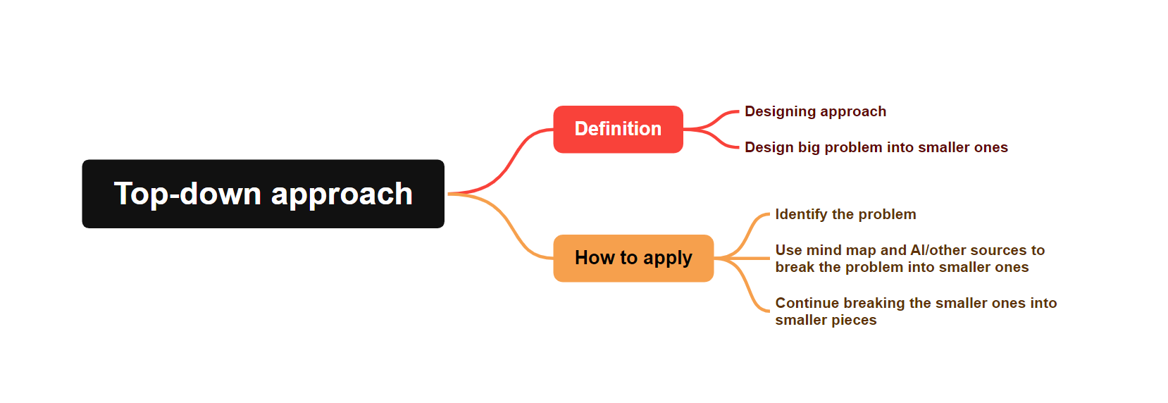
TOP DOWN APPROACH

Slide 3




HOW TO LEARN AND LEARN FAST
LEARN FROM THE OTHERS
LEARN BY EXPERIENCE
MAKE USE OF EVERY AVAILABLE RESOURCE

Slide 4
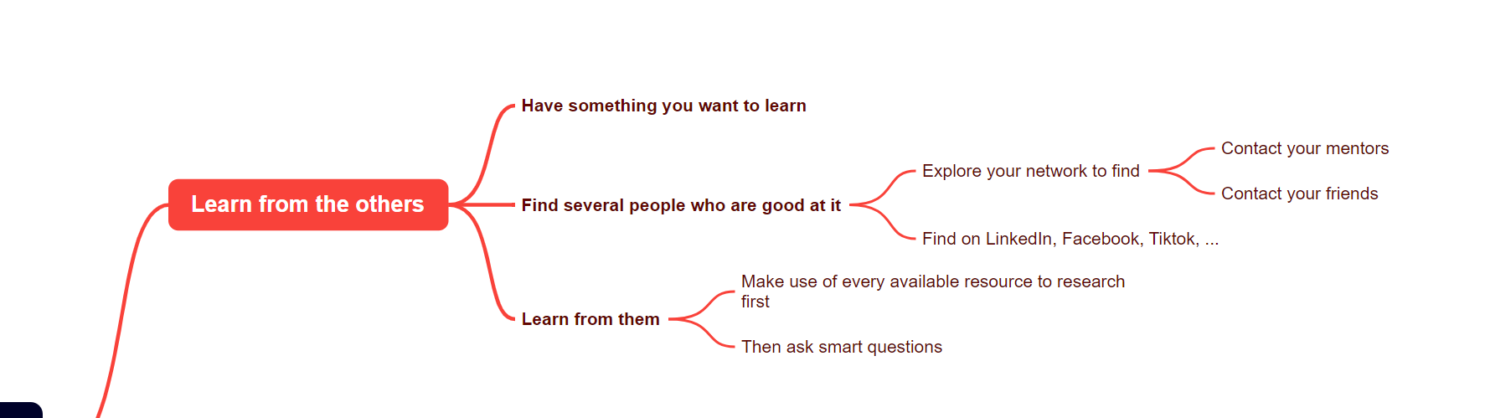
LEARN FROM THE OTHERS

Slide 5
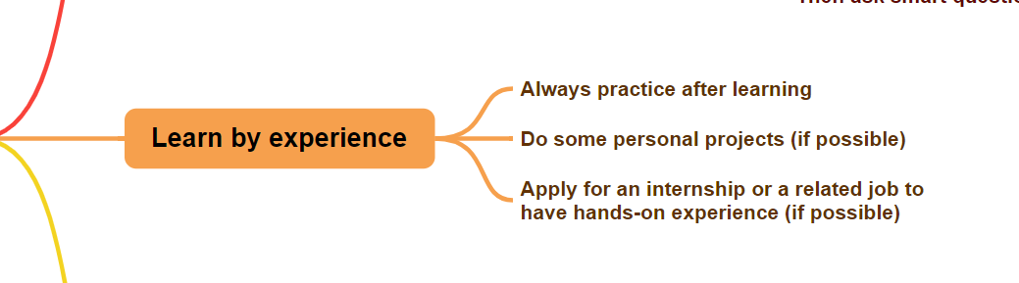
LEARN BY EXPERIENCE

Slide 6
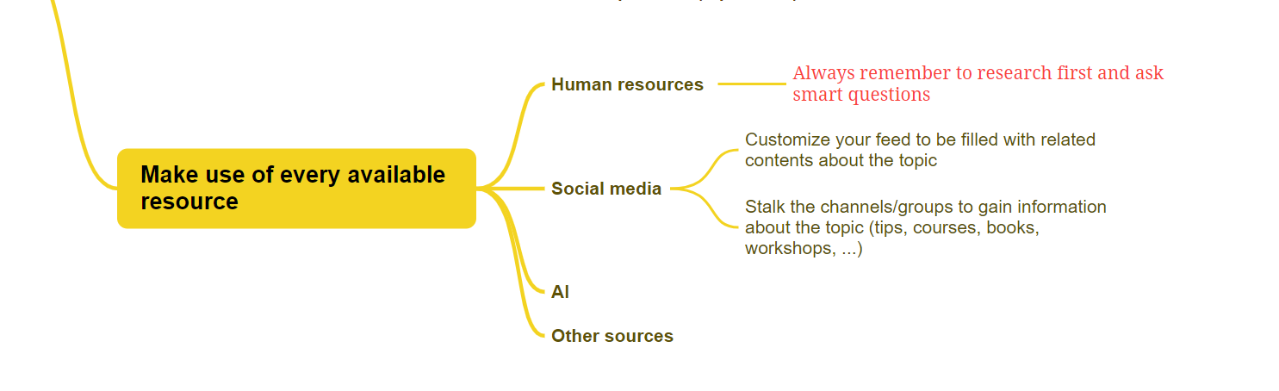
MAKE USE OF EVERY AVAILABLE RESOURCE

Slide 7

AUTONOMY AT
WORK
DEFINITION
1
Ownership but with boundaries and constraints, alignment -> Alignment enables autonomy
SIGNS OF AN AUTONOMOUS EMPLOYEE
2
WHY AUTONOMY AT WORK IS IMPORTANT
3

Slide 8
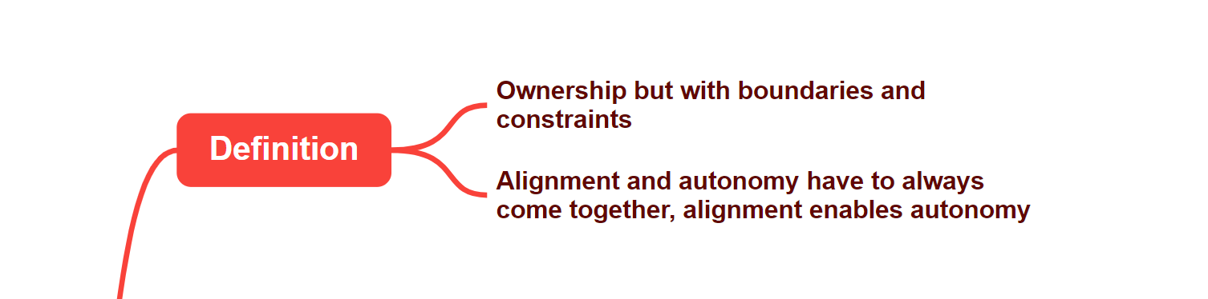
WHAT IS AUTONOMY AT WORK

Slide 9

SIGNS OF AN AUTONOMOUS EMPLOYEE
Accountability
Initiative
Respectful attitude
Continuous learning

Slide 10
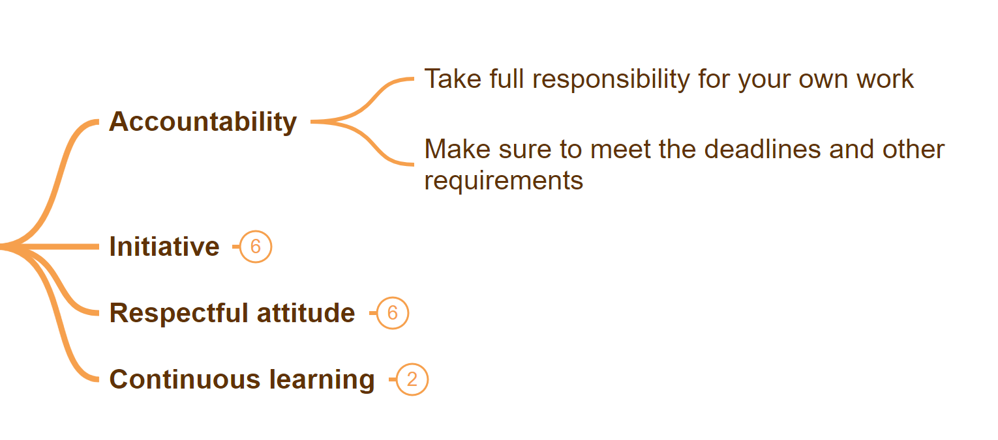
ACCOUNTABILITY

Slide 11
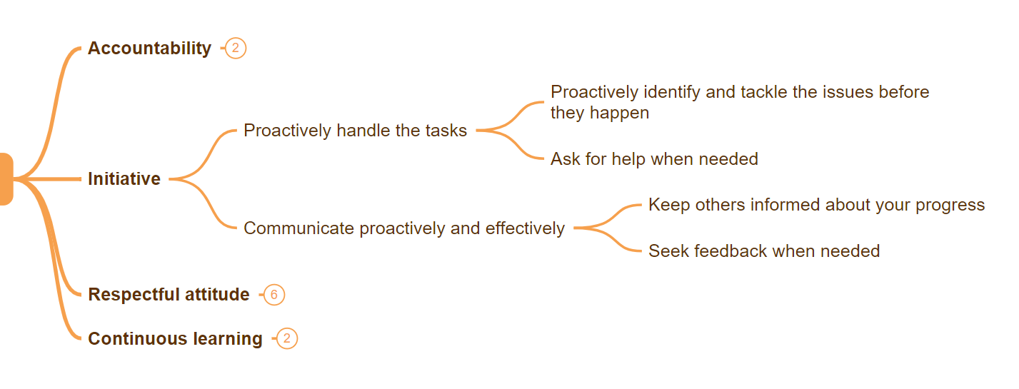
INITIATIVE

Slide 12
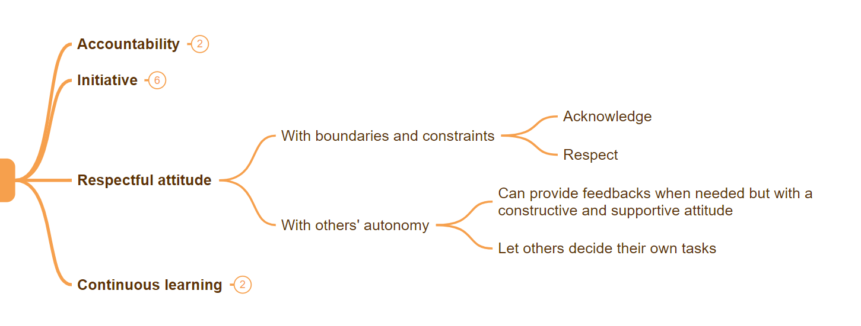
RESPECTFUL ATTITUDE

Slide 13
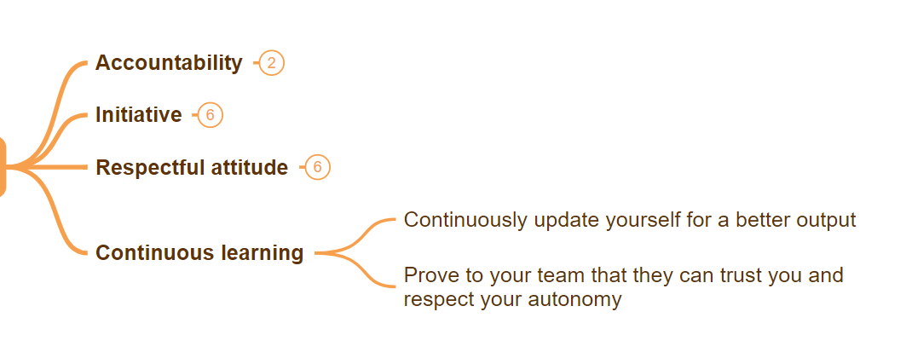
CONTINUOUS LEARNING

Slide 14
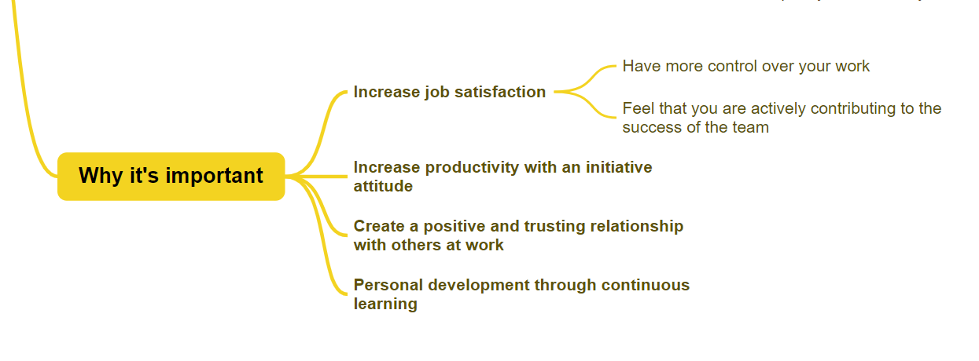
WHY AUTONOMY
AT WORK IS IMPORTANT

Slide 15
ASKING SMART QUESTIONS
WHAT MAKES A
SMART QUESTION
1
HOW TO APPLY SMART QUESTIONS
2

Slide 16

WHAT MAKES A SMART QUESTION
Open-endedness
Clarity
Comprehensiveness
Non-triviality
Critical thinking

Slide 17
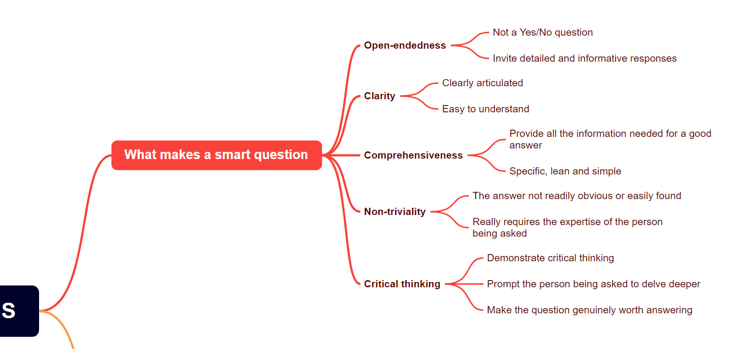

Slide 18
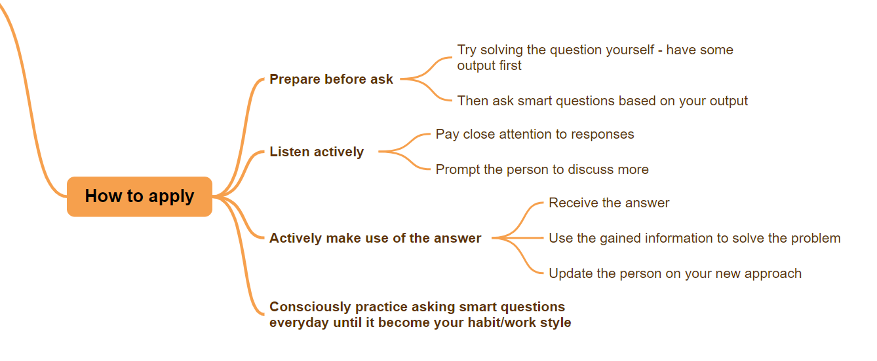
HOW TO APPLY SMART QUESTIONS

Slide 19
THANKS FOR READING
JOURNEY TO YOUR BEST
Khuat Bao Nguyen

